Slide 1
The Great Escape:
Transitioning to InfoSec from elsewhere - the what, why and how

Slide 2
Topics to be covered today
Introduction
My background
Usual Points of Entry
Main Domains and Roles
Main Tips to succeed
College courses
Certifications
Community
Online Resources
Conferences

Slide 3





Introduction
Jack Baylor
https://ie.linkedin.com/in/jackbaylor
Breaking Into InfoSec
@2wiredSecurity

Slide 4
My Background
UCC Computer Science
CIT Business Information Systems
Helpdesk for “Big Oil”
Customer Support for “Big Data”
Helpdesk for MSP

Slide 5
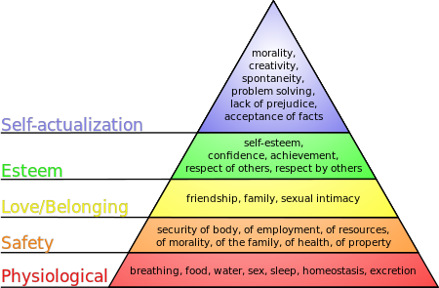

Slide 6
My Background
Team Lead for MSP – CompTIA A+ / Network+ / Security+
Deskside Support for “Big Finance”
Security Engineer for telco / semiconductor – multiple talks at CorkSec
Senior Threat Researcher for AI AV company

Slide 7
Introduction to InfoSec as a career
Basic definition:
the state of being protected against the unauthorized use of information, especially electronic data, or the measures taken to achieve this.

Slide 8
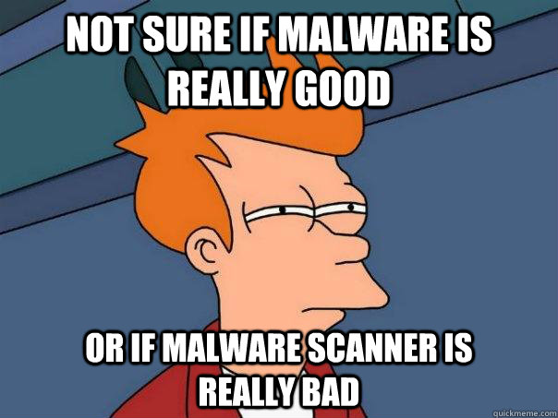
Notes:
Even today some people still believe that malware is a non-issue, especially if you’re a home user or small business.
“I don’t go to porn sites, of click on dodgy links, I’ll never be infected”. Unfortunately, that’s more often than not just fantasy.

Slide 9
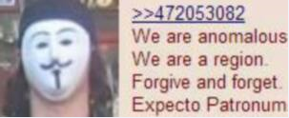
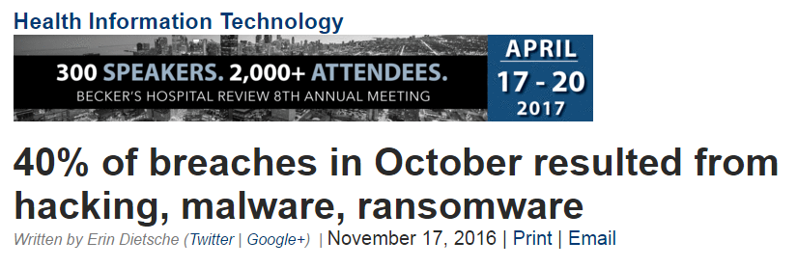
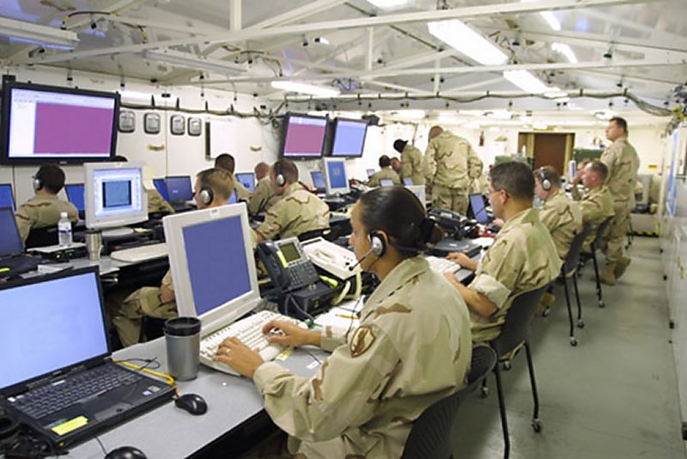
Cyber Crime and the Modern World
http://www.beckershospitalreview.com/healthcare-information-technology/40-of-breaches-in-october-resulted-from-hacking-malware-ransomware.html
Notes:
Before we go further, we do need to add a reality check.
Not all breeches occur because of Hacktivists or Nation States, a lot of the time its through human error, greed or desires for revenge.
Malware isn’t the primary reason for breeches, in fact in some industries its not even the Major reason, but it is one that needs to be addressed Defence-in-depth is the nature of our game, so we have to mitigate risk at every point possible

Slide 10

Notes:
Well, if its not the primary cause, you as, who cares?

Slide 11
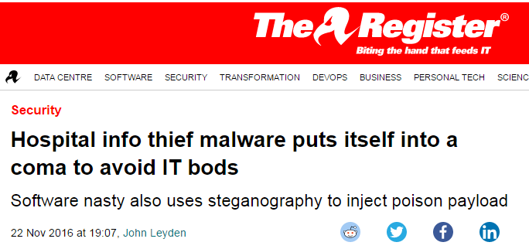
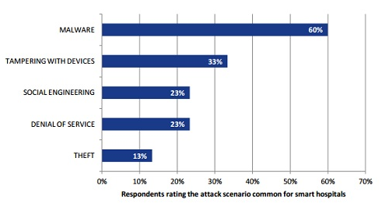
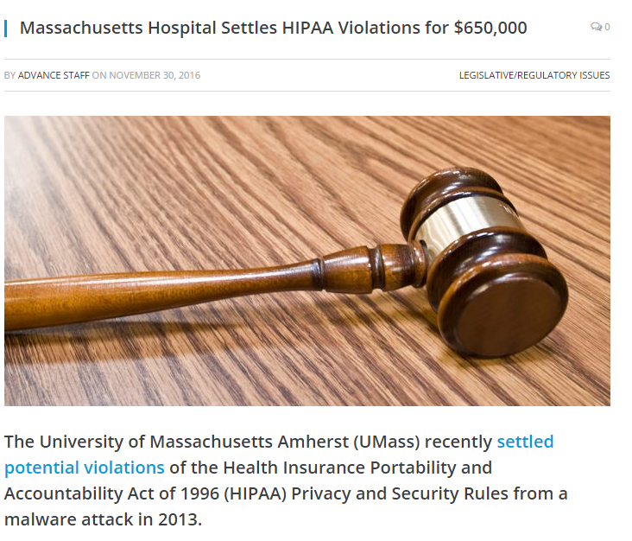
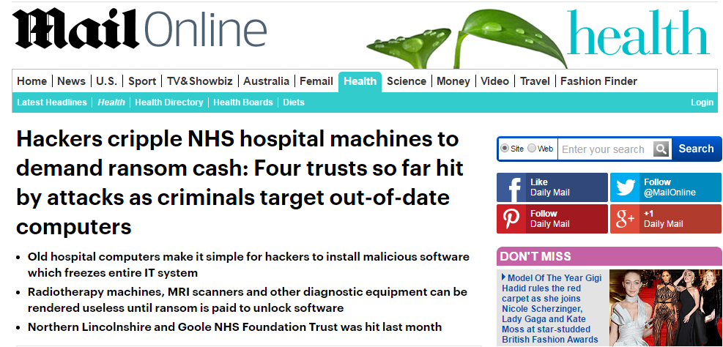
Notes:
So, why should we care?
We’re not countries with secrets, whats the worst that could happen, right?
Well, if you operate within any regulated industry, from healthcare to pharma to universities to widget factories:
HIPPA
PCI DSS
EU Data Protection Act
Local gov laws
At a personal level, ransomware or viral infections could destroy an individuals screen play, PhD thesis, or “priceless” anime collection

Slide 12
Notes:
In 2014 Cisco claimed there were as many as 1 million unfilled positions in InfoSec.
In 2018 Cybersecurity Ventures say that 3.5 million by 2021
In US industry average salare is $116k or $55.77 per hour
That's nearly three times the national median income for full-time wage and salary workers

Slide 14
Usual Points of Entry
Systems Administrators
Database Engineers
Full Stack Developers
Information Technology Analyst
Information Systems Analyst
Computer Systems Analyst
Notes:
Systems Administrators – Security Engineers, network security inc firewalls and all those lovely blinky boxes
Database Engineers – Identity Access Management, Risk Analysts, Disaster Recovery, Security Engineers
Full Stack Developers – Secure Application Lifecycle education and auditing, malware analysis, Reverse engineering Software Testing, Web application penetration testing
Information Technology Analyst – Information Security Analyst, SOC, IR
Information Systems Analyst – IDAM, SOC
Computer Systems Analyst – Network Security, Forensics, IR, Malware Analyst

Slide 15
Main Security Domains
Security and Risk Management
Asset Security
Identity & Access Management
Communications & Network Security

Slide 16
Main Security Domains
Security Assessment & Testing
Security Operations
Software Development Security
Security Engineering

Slide 17
Security and Risk Management
Risk=Impact X Probability / Cost
NIST Risk Management Framework SP 800-30
ISO27001 Cybersecurity Risk Framework
Other bespoke eg Vendor Security Alliance
Risk recognition, reduction, mitigation
How do I get into this?
Auditors, Finance, Business Intelligence
General IT roles such as administrator, architect, management
Risk framework certification, CRISC, CISSP, CISA, CISM
Project Management – CAPM -> PMP / Prince2
Notes:
Risk management is the process of identifying, assessing and controlling threats to an organization's capital and earnings. These threats, or risks, could stem from a wide variety of sources, including financial uncertainty, legal liabilities, strategic management errors, accidents and natural disasters
This is also going to include Threat Modelling
Long and short: How can you put a value on damages if you don’t know the worth of your assets?
$1 million in protection for $100k of value?
$5 lock to protect a $100k device?

Slide 18
Asset Security
Physical access = direct pawnage!
Biometrics, mantraps, physical access management
From traditional security or technical roles
Social engineering awareness
Correct fire precautions etc
CISSP, Vendor specific certs, experience
CATCH JAMES BOND AND BRING HIM TO ME!
Notes:
Physical security is still important as physical ownership is king

Slide 19
Communications & Network Security
Network Security
Firewalls
Encryption at rest and in transit
Authentication
Its all about that uptime, baby!
Entry point:
Network Engineer or Email admin
Certs include
CISCO CCNA -> CCNA Security
Juniper, CITRIX, Palo Alto etc

Slide 20
Identity & Access Management
Authentication, valid access, non-repudiation
Single SignOn, LDAP eg Radiant Logic, Active Directory
Access control lists, federated vs unfederated
UI design and development, support, engineer, architect
How do I get into this?
Database or System Engineer
Programming
UX UI design and implementation
Certifications include:
Certified Identity and Access Manager (vendor neutral)
CISSP
Notes:
Whats the difference between LDAP and Active Directory? LDAP (Lightweight Directory Access Protocol) is an application protocol for querying and modifying items in directory service providers like Active Directory, which supports a form of LDAP. Short answer: AD is a directory services database, and LDAP is one of the protocols you can use to talk to it.
Collaborates to create configuration designs for design and implementation of various environments
IAM developer skillsets include NET, and Java/J2EE and related technologies; Knowledge of SCIM, SPML, SAML, OAuth, OpenID, XACML and other security/IAM related standards; Strong LDAP programming skills;

Slide 21
Security Assessment & Testing
Web application and Network Penetration testing
Vulnerability discovery for PCI DSS
Social engineering inc phishing, vhishing
Offensive or Defensive
Entry points include:
System admin
Programming
Physical Security
Certifications include
Offensive Security OSCP
CompTIA PenTest+
EC Council Certified Ethical Hacker (C|EH)
Notes:
Standard image of anyone in security - “hackerman:
Leverages standard attacks to iteratively remove entry points for attacker
Compiles detailed and comprehensive reports to assist blue team remedy all triaged discovered issues
Script kiddie vs pro
Saturated market but always scope to succeed for dedicated talent

Slide 22
Security Operations
Responding to alerts on multiple SIEM solutions
ArcSight
Splunk
Triage and respond appropriately - escalate from alert to incident
High volume, high stress, high performance
Entry points:
Helpdesk
Customer Support
Network Operations Centre
Sysadmin
Certifications:
CompTIA A+ -> Network+ -> Security+ -> CySA+
Notes:
SIEM – security incident event management SOC security operations center – the helpdesk of security
Not really, much more detailed than that.
High volume high stress
Learning via firehose

Slide 23
Security Engineering
Design, implement and maintain multiple complex security solutions
Includes:
Incident Response
Malware Analysis
Reverse Engineering
Data Loss Detection/Prevention ( DLD / DLP )
Automation Engineer
Entry points:
System Admin, Programmer/Developer, police & military, helpdesk, networking…
Notes:
Security engineering is a specialized field of engineering that focuses on the security aspects in the design of systems that need to be able to deal robustly with possible sources of disruption, ranging from natural disasters to malicious acts

Slide 24
Software Development Security
Design, implement, update systems with security in mind
Develop fully functional security solutions
Ensure that Secure Development Lifecycle is adhered to
Entry points:
Programmer
Developer
UX / UI
Notes:
Application security is the use of software, hardware, and procedural methods to protect applications from external threats.

Slide 25
Main Tips to Succeed
Find inspiration and mentors
Go for what excites you
Don’t specialize just in security
Network, contribute, mentor
Constantly improve and add to your toolbox
Legitimise your skills through certification
Never stop never stopping!
Notes:
Create a twitter account, get involved in study groups, basically all that’s covered in the Breaking Into Infosec page on Facebook

Slide 26
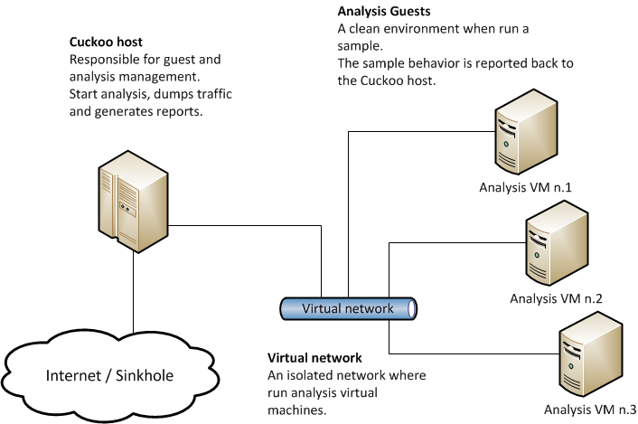
Lab Setup
Virtual Hyperviser
Oracle VirtualBox
VMWare Player
Linux VM
REMnux
Kali
Windows VM
Windows XP
Windows 7
Windows 8
Notes:
All you need is an old laptop or desktop with a hard-drive and a few gigs of RAM
Here we setup a Linux box, in my case REMnux but you can also use Kali, or simply install whatever flavour you want and put in the tools individually.
This will be used to intercept any “outbound” communications so we can monitor whats being asked for, and incrementally provide more functionality to the malware
The Windows VM can be one or all three of these, most malware is backwards compatible, but it helps to have images of all of them
Keep them unpatched and vulnerable.

Slide 27
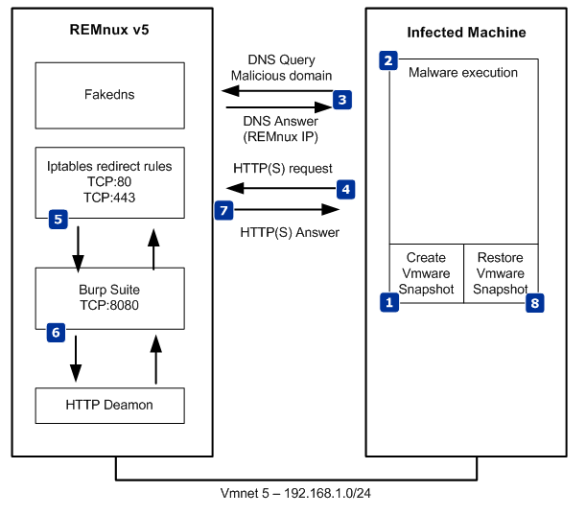
Basic Behavioural Analysis
Dual Box Behavioural Analysis
Fake a gateway server
Incrementally add functions
Notes:
Monitor outbound traffic request
Port 25: does it need smpt
port 53 Does it need dns:
port 80 443 Does it need http:
port 20-21 Does it need ftp:
Does it need IRC: 66659-6669
1080 Does it need Doom :D

Slide 28
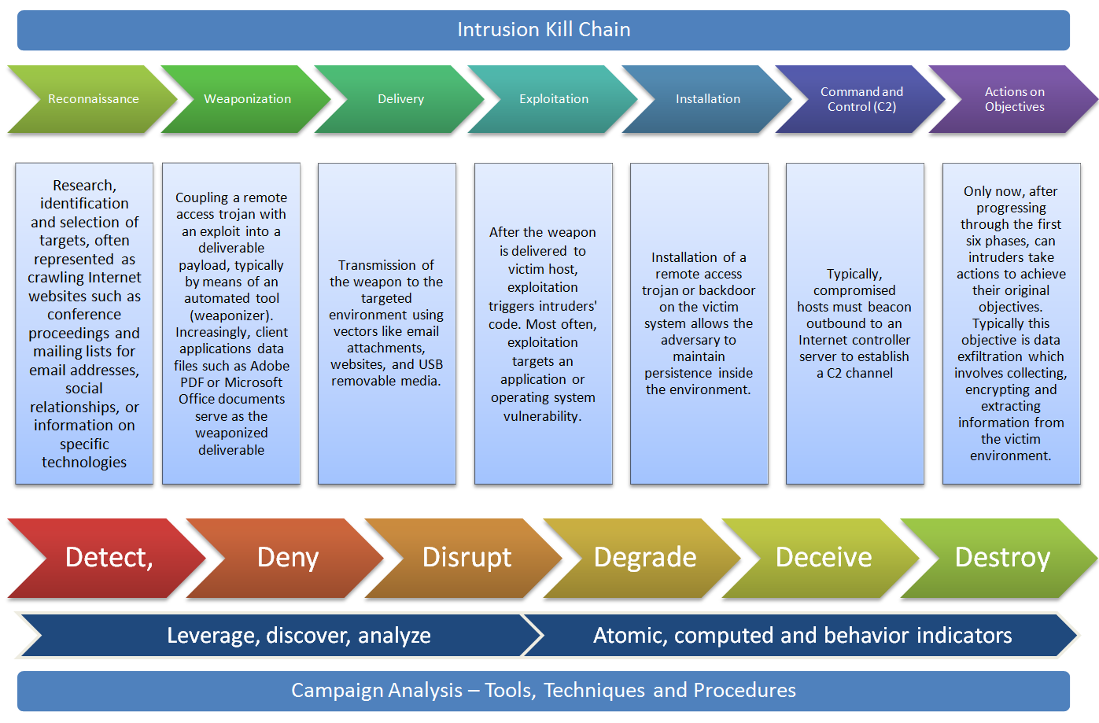
Cyber Killchain
Notes:
So, we covered the “Why”, we set up a little of the “How”, now we look at the WHEN…..
When does Malware Analysis even take place?
Here we have Lockheed Martin’s Cyber Intrusion Killchain.

Slide 29
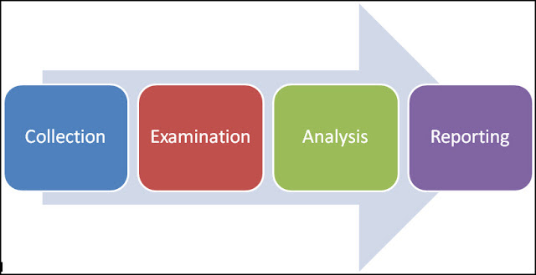
Methodology of a Malware Analyst
Notes:
In 2006, the National Institute of Standards and Technology (NIST) released the special publication 800-86 Guide to Integrating Forensic Techniques into Incident Response

Slide 30
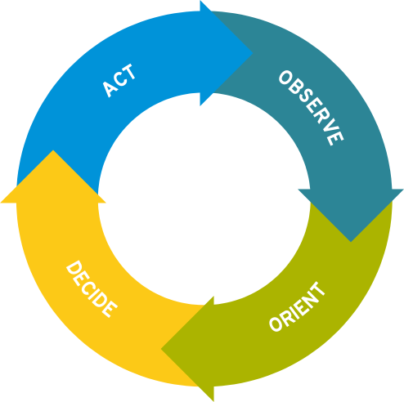
Methodology of a Security Engineer
Automated Analysis
Static analysis
Behavioural / Dynamic Analysis
Notes:
All the time utilize the OODA loop:
Observe: leverages situational awareness
Orient: leverages situational understanding
Decide: situational judgement
Action: situational influence

Slide 31

The InfoSec Mindset
Notes:
Adam Savage - MythBusters It is for this reason that taking notes is the single most important thing an analyst can do. YOU may need to justify your pivoting from one piece of information to another, our you may need to return to a sample days or weeks after your initial investigations.

Slide 32
College courses: Masters
IT Blanchardstown (skillnet) MSc in Cyber Security (online)
Cork Institute of Technology MSC in Information Security (online)
University College Dublin MSc Forensic Computing & Cybercrime Investigation
Dublin Institute of Technology MSc Computing (Security & Forensics)
Dublin City University: International Master in Security, Intelligence
Griffith: MSc in Information and Network Security
University of Limerick Meng of Information and Network Security
Letterkenny MSc in Systems and Software Security

Slide 33
Certifications
CompTIA
A+ -> Network+ -> Security+ ->CySA+ -> CASP
ISC²
SSCP -> CISSP -> CSSLP / CCSP
Offensive Security:
OSCP -> OSCE
ISACA
CRISC -> CISA -> CISM
CISCO
CCNA Security -> CCNP Security -> CCIE Security
Notes:
CASP CompTIA Advanced Security Practitioner
SSCP Systems Security Certified Practitioner
CISSP Certified Information Systems Security Professional CCSP Certified Cloud Security Professional (CCSP)
OSCP Offensive Security Certified Professional

Slide 34
Groups
Defcon (hey, that’s us!)
Hack the Planet!
OWASP
OWASP Top 10 and Web Top 10
ISACA
focused on IT governance
IT@Cork
Covers full industry stack of IT and IT-adjacent companies and services
University and IT specific clubs and societies
Networking, fun and information sharing
Notes:
ISACA Information Systems Audit and Control Association

Slide 35
Online Resources
CorkSec.com
You’re friendly neighborhood DefCon group!
Facebook groups
Eg: Breaking into InfoSec
Cybrary.it
Small to medium online courses – free
Massive online courses
Eg: edX, Coursera, Khan academy
SecurityTube.net
Curated conference talks
YouTube, Github, basically just Google what you’re looking for!

Slide 36
Conferences
DefCon
4 days Thursday – Sunday in Las Vegas
Blackhat
4 day Monday – Thursday in Las Vegas
B-Sides
Multiple cities worldwide
SteelCon
3 days in June in North of England
HackInParis
2 days Paris France in June
Recon
3 days Brussels in Feb

Slide 37
Any Questions?

